Slide 1


Michael Simony
6. Of December 2025

Slide 2

Outline
Executive Summary
Introduction
Methodology
Results
Conclusion
Appendix

Slide 3
Executive Summary
Summary of methodologies
Summary of all results

Slide 4
Introduction
This capstone project demonstrates the complete data science workflow applied to a real-world dataset. The goal is to showcase skills in data collection, wrangling, exploratory analysis, visualization, and predictive modeling using Python, SQL, Folium, and Plotly Dash.
Project background and context The project focuses on analyzing [insert dataset/topic, e.g., “spacex launch data”] to uncover patterns and insights that support data-driven decisions.
Problems you want to find answers - What trends and relationships exist in the data? - Can we build predictive models to classify outcomes and improve decision-making?

Slide 5

Section 1

Slide 6
Methodology
Executive Summary
Data collection methodology:
Gathered data from [source, e.g., public datasets, APIs, company databases].
Perform data wrangling
Cleaned and transformed the data using Python (pandas), addressing missing values, outliers, and formatting issues.
Perform exploratory data analysis (EDA) using visualization and SQL
Used Python, pandas, and visualization libraries (matplotlib, seaborn) to explore data distributions, relationships, and trends.
Perform interactive visual analytics using Folium and Plotly Dash
Developed interactive maps with Folium and dashboards with Plotly Dash to present results.
Perform predictive analysis using classification models
Predict outcomes. That approach involves classification models. Typical tasks include Building the model, Training the model, Tuning hyperparameters and Evaluating the model.

Slide 7
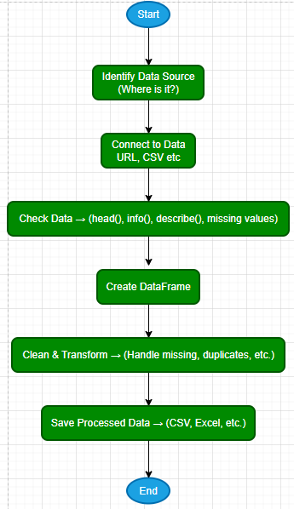
Data Collection
Data Collection is the process of gathering and measuring information on variables of interest, in an established systematic way, to answer research questions, evaluate outcomes, or make informed decisions. It can be done manually or automatically, and the data can come from various sources.
Key Phrases: What to Collect:
User Data: Demographics, purchase history, saved/liked products, search history, and most visited products.
Product Data: Inventory details, ingredients, popularity, customer ratings.
Sources: Databases, transaction logs, user interactions.
Time-Consuming: Yes. Collecting and identifying relevant data sources can be labor-intensive.

Slide 8
Data Collection – SpaceX API
Define the URL
Get the data response=requests.get(static_json_url)
Check the data response.status_code (=200)
Convert data to DataFrame data = pd.json_normalize(response.json())
See the DataFrame Head data.head(5)
File Name: jupyter-labs-spacex-data-collection-api
MichSimo1962/testpro

Slide 9
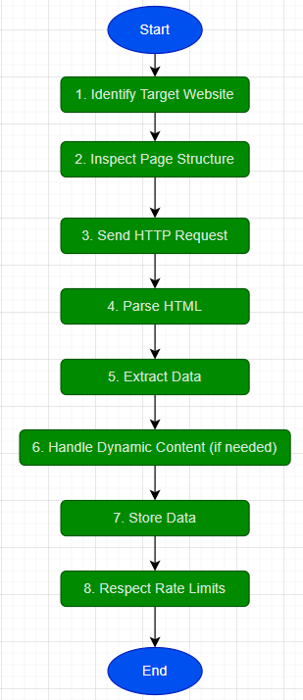
Data Collection - Scraping
Key Phrases
Define Target URL
Review legal and rights
Inspect Page Structure
Send HTTP request
Parse HTML
Extract Data
Store Data
GitHub URL

Slide 10
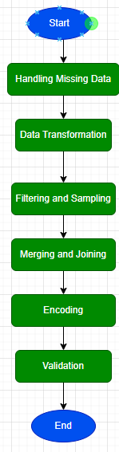
Data Wrangling
Data Wrangling refers to the process of cleaning, transforming, and organizing raw data into a structured and usable format for analysis. It is a critical step in any data science workflow because real-world data often contains inconsistencies, missing values, and irrelevant information.
Key Activities in Data Wrangling
Handling Missing Data: Replace null values with mean, median, or most frequent values.
Data Transformation: Convert data types, normalize values, and create new derived features.
Filtering and Sampling: Remove irrelevant records (e.g., filtering out Falcon 1 launches in SpaceX data).
Merging and Joining: Combine data from multiple sources such as APIs and web scraping.
Encoding: Apply techniques like one-hot encoding for categorical variables.
Validation: Ensure data consistency and integrity before analysis.
GitHub URL

Slide 11
EDA with Data Visualization
Scatter plot transform abstract numbers into visual patterns and making it easier to interpret relationships.
Scatter (Flight Number/Launch Site) – CCAFS have most flights. Class 0 and 1. Easy to quickly get an overview for the three Launch Sites
Scatter (Payload Mass/ Launch Site – CCAFS and KSC have the heavy flights. This chart show clearly how two Sites are used for heavy weight.
Bar chart(success rate/each orbit type) – four have most success, one no flight. This kind of chart make it easy to show patterns and differences between groups.
Line Plot (Year/Succes) – shows that the success has increased over the years.
https://github.com/MichSimo1962/testpro/blob/main/edadataviz.ipynb

Slide 12
EDA with SQL
%sql SELECT DISTINCT "Launch_Site" FROM SPACEXTABLE
%sql SELECT * FROM SPACEXTABLE WHERE "Launch_Site" LIKE '%CCA%' LIMIT 5;
%sql SELECT SUM("PAYLOAD_MASS__KG_") AS Total_Payload_Mass FROM SPACEXTABLE WHERE "Customer" = 'NASA (CRS)’;
%sql SELECT AVG("PAYLOAD_MASS__KG_") AS Total_Payload_Mass FROM SPACEXTABLE WHERE "Booster_Version" = 'F9 v1.1’;
%sql SELECT MIN(DATE) AS Frist_Success_Ground FROM SPACEXTABLE WHERE Landing_Outcome = 'Success (ground pad)’;
%sql SELECT * FROM SPACEXTABLE WHERE Landing_Outcome = 'Success (drone ship)' AND PAYLOAD_MASS__KG_ > 4000 and PAYLOAD_MASS__KG_ < 6000;
%sql SELECT Mission_Outcome, COUNT(*) AS Total FROM SPACEXTABLE GROUP BY Mission_Outcome;
%sql SELECT DISTINCT Booster_Version FROM SPACEXTABLE WHERE PAYLOAD_MASS__KG_ = (SELECT MAX(PAYLOAD_MASS__KG_) FROM SPACEXTABLE);
%sql SELECT Date,Booster_Version,Launch_Site, substr(Date, 6,2) FROM SPACEXTABLE WHERE substr(Date,0,5)='2015' and Landing_Outcome = 'Failure (drone ship)’;
%sql SELECT Landing_Outcome, COUNT(*) AS Total FROM SPACEXTABLE GROUP BY Landing_Outcome ORDER BY Total DESC;
https://github.com/MichSimo1962/testpro/blob/main/jupyter-labs-eda-sql-coursera_sqllite.ipynb

Slide 13
Build an Interactive Map with Folium
Summarize what map objects such as markers, circles, lines, etc. you created and added to a folium map
Explain why you added those objects
Add the GitHub URL of your completed interactive map with Folium map, as an external reference and peer-review purpose

Slide 14
Build a Dashboard with Plotly Dash
Summarize what plots/graphs and interactions you have added to a dashboard
Explain why you added those plots and interactions
Add the GitHub URL of your completed Plotly Dash lab, as an external reference and peer-review purpose

Slide 15
Predictive Analysis (Classification)
Summarize how you built, evaluated, improved, and found the best performing classification model
You need present your model development process using key phrases and flowchart
Add the GitHub URL of your completed predictive analysis lab, as an external reference and peer-review purpose

Slide 16
Results
Exploratory data analysis results
Interactive analytics demo in screenshots
Predictive analysis results

Slide 17

Section 2

Slide 18
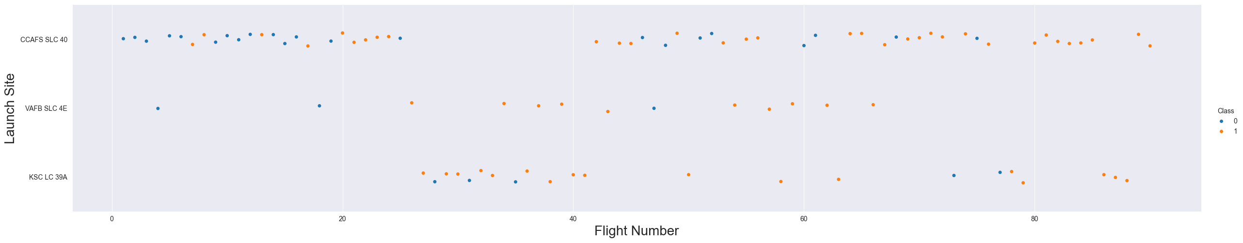
Flight Number vs. Launch Site
Class 1 Dominance in Later Flights:
For CCAFS SLC 40 and KSC LC 39A, Succes flight becomes more prevalent in higher flight numbers, suggesting improvements or changes in operations over time.
Launch Site Usage:
CCAFS SLC 40 is used consistently across all flight numbers.
KSC LC 39A is used more frequently in later flight numbers.
VAFB SLC 4E is used less frequently and mostly for failed flights

Slide 19
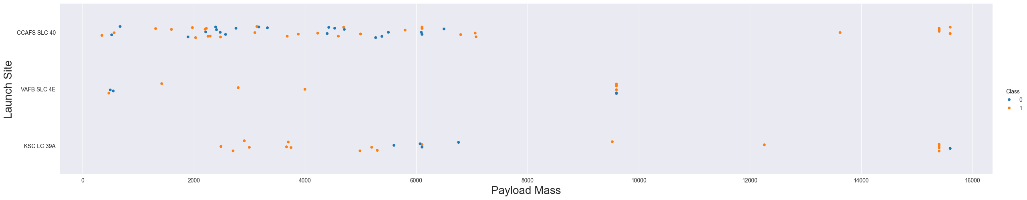
Payload vs. Launch Site
Payload Mass and Launch Site Usage:
CCAFS SLC 40 is versatile, handling a wide range of payload masses for both classes.
VAFB SLC 4E is used less frequently and primarily for lower payload masses.
KSC LC 39A is predominantly used for higher payload masses, especially those above 10,000 kg.
Class Distribution:
For CCAFS SLC 40, both classes are distributed across the payload mass range, indicating a balanced usage for different mission types or outcomes.
For KSC LC 39A, class 1 (orange) is more prevalent for higher payload masses, suggesting it might be preferred for heavier or more critical payloads.
CCAFS has most launches, but none at same size than VAFB at maximum.

Slide 20
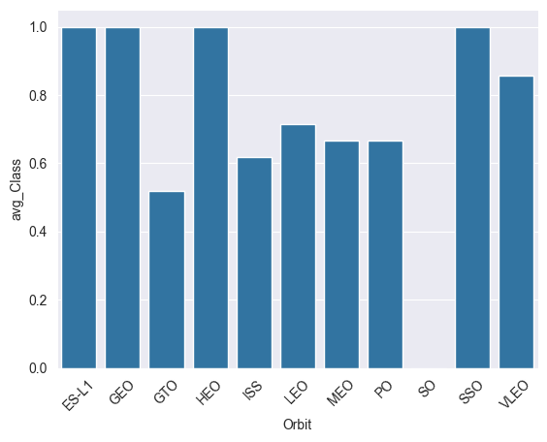
Success Rate vs. Orbit Type
ES-L1, GEO, GTO, HSO and SSO have the highest average classification performance.
LEO, MEO and PO have moderate performance
ISS and SO have the lowest performance.
There is a noticeable variability in classification performance across different orbits.

Slide 21
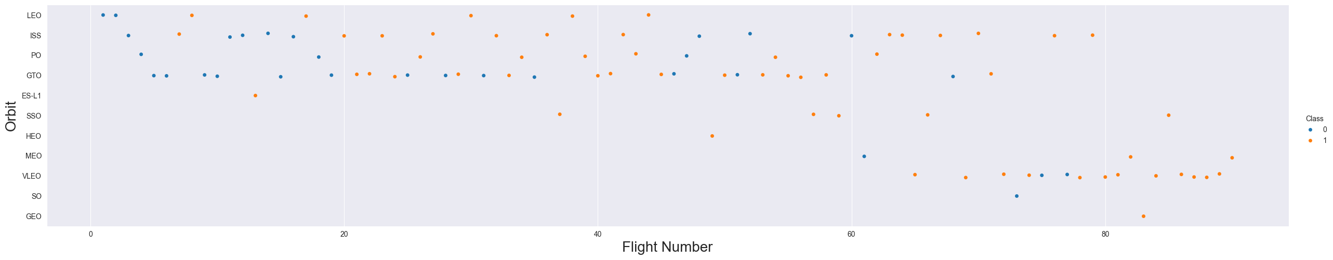
Flight Number vs. Orbit Type
LEO, ISS, PO, GTO, SSO, and HEO are frequently used across a wide range of flight numbers, indicating their commonality or importance in various missions.
ES-L1, MEO, and GEO are less frequently used, with data points scattered across fewer flight numbers.
VLEO and SO are predominantly class 1 in higher flight numbers, which might indicate improvements, specific mission requirements, or operational changes over time.

Slide 22
Payload vs. Orbit Type
CCAFS SLC 40 is versatile, handling a wide range of payload masses for both classes, indicating its flexibility for various mission types.
VAFB SLC 4E is used less frequently and primarily for lower payload masses, suggesting it may be specialized for lighter payloads.
KSC LC 39A is predominantly used for higher payload masses, especially those above 10,000 kg, indicating its capability to handle heavier payloads.

Slide 23
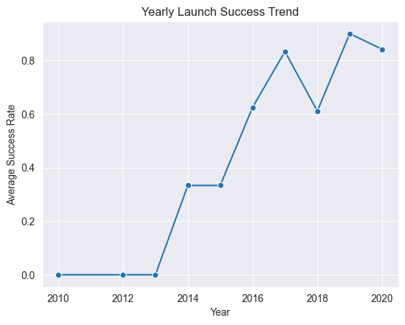
Launch Success Yearly Trend
From 2010 to 2013, there were no successful launches, indicating initial challenges or a period of development and testing.
Starting in 2014, there is a noticeable improvement in launch success rates, suggesting advancements in technology, processes, or operational efficiency.
From 2017 onwards, the success rate significantly increases, peaking in 2019 with a 100% success rate. This indicates a period of high reliability and success in launches.
While there are slight fluctuations in 2018 and 2020, the overall trend from 2017 onwards remains high, suggesting sustained improvements and consistency in launch success.

Slide 24
All Launch Site Names
The names of the unique launch sites
The query that has been used is this one: %sql SELECT DISTINCT "Launch_Site" FROM SPACEXTABLE Useful for identifying all unique launch sites in the dataset, which can help in filtering, grouping, or analyzing launch data by site.
Launch_Site
CCAFS LC-40
VAFB SLC-4E
KSC LC-39A
CCAFS SLC-40

Slide 25
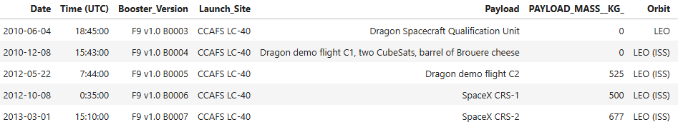
Launch Site Names Begin with 'CCA'
Here are 5 records where launch sites begin with `CCA`
The query that has been used is this one: %sql SELECT * FROM SPACEXTABLE WHERE "Launch_Site" LIKE '%CCA%' LIMIT 5; Useful for quickly inspecting data related to launch sites containing "CCA" (e.g., Cape Canaveral Air Force Station) without retrieving the entire dataset.

Slide 26
Total Payload Mass
The total payload carried by boosters from NASA is:
The query that has been used is this one: %sql SELECT SUM("PAYLOAD_MASS__KG_") AS Total_Payload_Mass FROM SPACEXTABLE WHERE "Customer" = 'NASA (CRS)’; Useful for analyzing the cumulative payload mass launched for NASA's Commercial Resupply Services (CRS) missions, providing insight into the total cargo or equipment sent to space for these missions.
Total_Payload_Mass
45596

Slide 27
Average Payload Mass by F9 v1.1
The average payload mass carried by booster version F9 v1:
The query that has been used is this one: %sql SELECT AVG("PAYLOAD_MASS__KG_") AS Total_Payload_Mass FROM SPACEXTABLE WHERE "Booster_Version" = 'F9 v1.1’; Useful for analyzing the cumulative payload mass launched for F9 v1.1 Booster Version missions, providing insight into the average Payload mass sent to space for these missions.
Total_Payload_Mass
2928.4

Slide 28
First Successful Ground Landing Date
The date of the first successful landing outcome on ground pad was:
The query that has been used is this one: %sql SELECT MIN(DATE) AS Frist_Success_Ground FROM SPACEXTABLE WHERE Landing_Outcome = 'Success (ground pad)’; Useful for analyzing the dates for all the missions, providing insight using the MIN function for sent to space for these missions and had a outcome with succes.
Frist_Success_Ground
2015-12-22

Slide 29
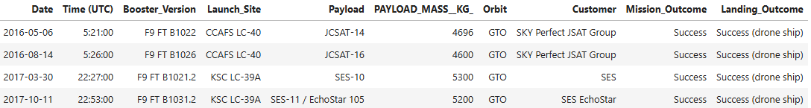
Successful Drone Ship Landing with Payload between 4000 and 6000
List the names of boosters which have successfully landed on drone ship and had payload mass greater than 4000 but less than 6000:
The query that has been used is this one: %sql SELECT * FROM SPACEXTABLE WHERE Landing_Outcome = 'Success (drone ship)' AND PAYLOAD_MASS__KG_ > 4000 and PAYLOAD_MASS__KG_ < 6000; Here the column Landing_Outcome is used to selected the Succes critical together with the Payload_Mass_kg limited between 4000 and 6000 kg.

Slide 30
Total Number of Successful and Failure Mission Outcomes
Calculate the total number of successful and failure mission outcomes:
The query that has been used is this one: %sql SELECT Mission_Outcome, COUNT(*) AS Total FROM SPACEXTABLE GROUP BY Mission_Outcome; The COUNT function is used on column “Mission_Outcome” and it returns the number of launches for each unique launch site and then it is order in groups.
Mission_Outcome | Total
Failure (in flight) | 1
Success | 98
Success | 1
Success (payload status unclear) | 1

Slide 31
Boosters Carried Maximum Payload
List the names of the booster which have carried the maximum payload mass
The query that has been used is this one: %sql SELECT DISTINCT Booster_Version FROM SPACEXTABLE WHERE PAYLOAD_MASS__KG_ = (SELECT MAX(PAYLOAD_MASS__KG_) FROM SPACEXTABLE); It retrieves the distinct booster versions from a table called SPACEXTABLE for the record(s) where the PAYLOAD_MASS__KG_ (payload mass in kilograms) is equal to the maximum payload mass in the same table.
Booster_Version
F9 B5 B1048.4
F9 B5 B1049.4
F9 B5 B1051.3
F9 B5 B1056.4
F9 B5 B1048.5
F9 B5 B1051.4
F9 B5 B1049.5
F9 B5 B1060.2
F9 B5 B1058.3
F9 B5 B1051.6
F9 B5 B1060.3
F9 B5 B1049.7

Slide 32
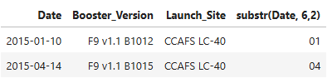
2015 Launch Records
List the failed landing_outcomes in drone ship, their booster versions, and launch site names for in year 2015:
The query that has been used is this one: %sql SELECT Date,Booster_Version,Launch_Site, substr(Date, 6,2) FROM SPACEXTABLE WHERE substr(Date,0,5)='2015' and Landing_Outcome = 'Failure (drone ship)’; This command retrieves specific information from a table called SPACEXTABLE for all missions that happened in 2015 and had a landing outcome of "Failure (drone ship)".

Slide 33
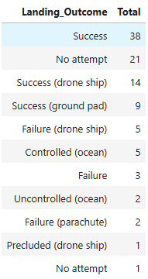
Rank Landing Outcomes Between 2010-06-04 and 2017-03-20
Rank the count of landing outcomes (such as Failure (drone ship) or Success (ground pad)) between the date 2010-06-04 and 2017-03-20, in descending order
The query that has been used is this one: %sql SELECT Landing_Outcome, COUNT(*) AS Total FROM SPACEXTABLE GROUP BY Landing_Outcome ORDER BY Total DESC; This command counts how many times each landing outcome occurred in the SPACEXTABLE and then sorts the results from most to least common.

Slide 34

Section 3

Slide 35
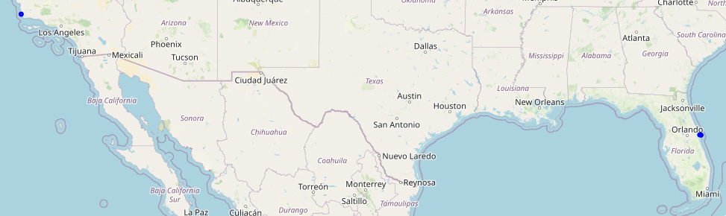
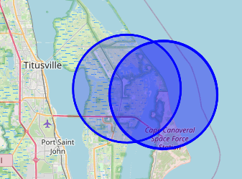
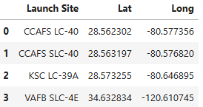
Map show the location for the Launch Sites
All launch sites on a map
The four Launch Sites are visible with blue markers on the map. There of
Three of them are placed in the same area, near Orlando. The last one is placed near Los Angeles. The little table shows the coordinate.

Slide 36
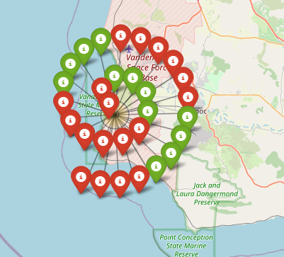
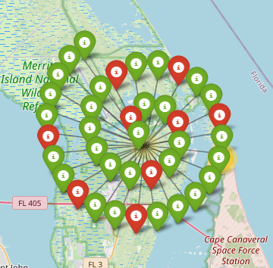
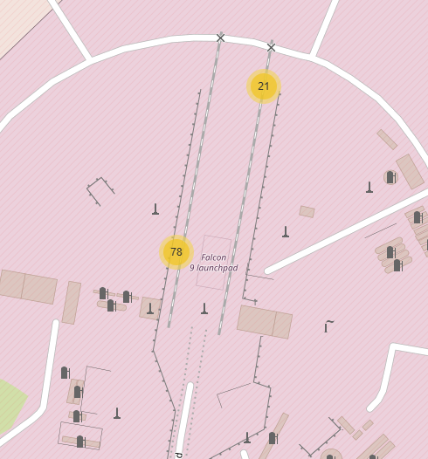
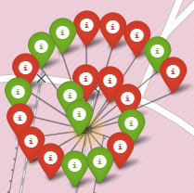
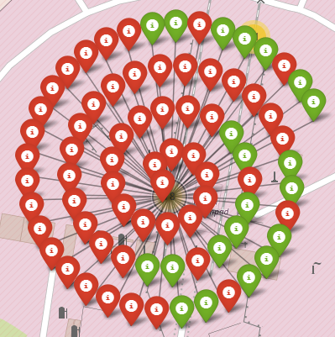
The success/failed launches for each site
VAFB
KSC
CCAFS LC & CCAFS SLC
VAFB has nearly 50/50 success/failed, while KSC has most succuss launches for all four sites. The two CCAF sites seems to be more like test sites with many failed launches.

Slide 37
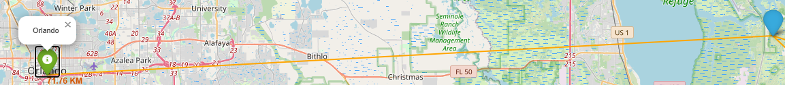
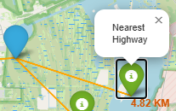
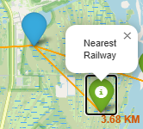
Distances between a launch site to its proximities
On the three screenshots, the distance are showed in km to Orlando, above and range 71.76 km, and nearest Highway and Railway.

Slide 38

Section 4

Slide 39
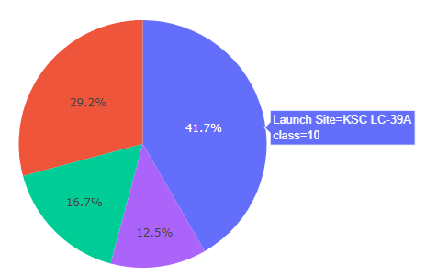
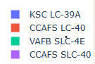
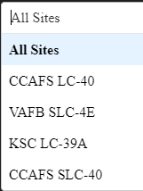
Launch Site Drop-down
KSC LC-39A Dominance: The largest portion of the dataset, 41.7%, is attributed to the KSC LC-39A launch site, which is classified as class=10. This indicates that KSC LC-39A is the most frequently used or significant site in this dataset.
Focus on KSC LC-39A: If this dataset represents launch frequency, resource allocation, or success rates, KSC LC-39A should be a primary focus for analysis, maintenance, or investment.
Class 10 Significance: The class designation (class=10) for KSC LC-39A might indicate a specific category or priority level, which could be important for further investigation or decision-making.

Slide 40
<Dashboard Screenshot 2>
Replace <Dashboard screenshot 2> title with an appropriate title
Show the screenshot of the piechart for the launch site with highest launch success ratio
Explain the important elements and findings on the screenshot

Slide 41
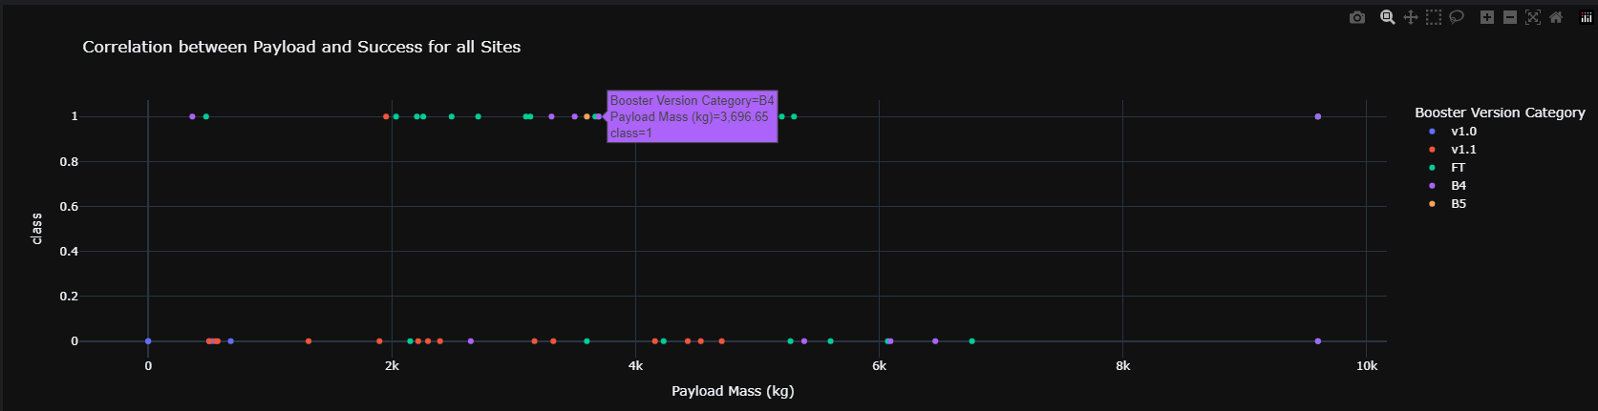
Payload and Success for all Sites
Most successful launches occur with payloads under 5,000 kg.
B4 and FT booster versions have the highest success rates.
B4, in particular, is highlighted as successful for a payload of 3,696.55 kg.

Slide 42

Section 5

Slide 43
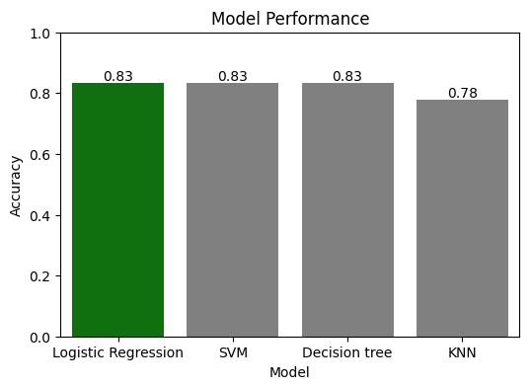
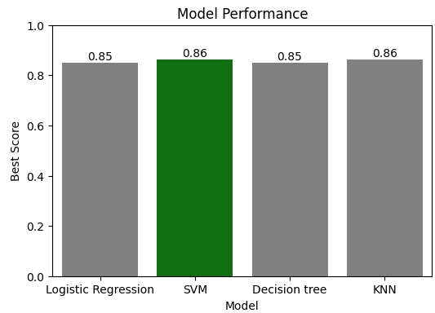
Classification Accuracy
Conclusion
Logistic Regression, SVM, and Decision Tree are equally effective for this dataset, each achieving an accuracy of 83%.
KNN is less accurate, with a performance of 78%.
If model accuracy is the primary criterion, Logistic Regression, SVM, or Decision Tree would be the preferred choices.
The Bar Chart below is made on Best Score instead and give another result.

Slide 44
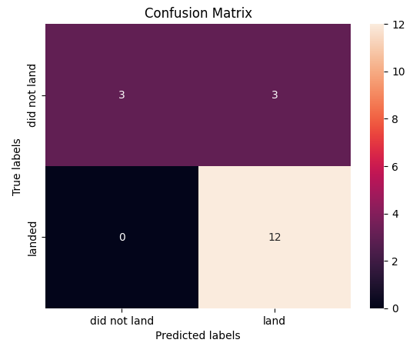
Confusion Matrix
Looking at the Accuracy, the best Method: Logistic Regression with accuracy: 0.8333333333333334
High Accuracy for "land": The model is very good at identifying successful landings, with 12 true positives and 0 false positives.
Moderate Performance for "did not land": The model correctly identified 3 true negatives, but it also misclassified 3 instances as "did not land" when they were actually "land" (false negatives).
No False Positives: The model did not incorrectly predict any "land" outcomes as "did not land," which is a strong point for avoiding false alarms in this context.
Overall Performance: The model performs well for the "land" class but has room for improvement in correctly identifying the "did not land" class.

Slide 45
Conclusions
In the last exercise, one can optimize the four models and thereby achieve greater accuracy.
The first three Logistic Regression, SVM and Decision Tree give almost the same accuracy, whereas KNN is somewhat lower in accuracy when using "Accurate“

Slide 46
Appendix
Include any relevant assets like Python code snippets, SQL queries, charts, Notebook outputs, or data sets that you may have created during this project

Slide 47


